Slide 1


Big Data Infrastructure
CS 489/698 Big Data Infrastructure (Winter 2017)
Week 3: From MapReduce to Spark (1/2)
January 17, 2017
Jimmy Lin
David R. Cheriton School of Computer Science
University of Waterloo
These slides are available at http://lintool.github.io/bigdata-2017w/
This work is licensed under a Creative Commons Attribution-Noncommercial-Share Alike 3.0 United States See http://creativecommons.org/licenses/by-nc-sa/3.0/us/ for details

Slide 2

Source: Wikipedia (The Scream)

Slide 3
Debugging at Scale
Works on small datasets, won’t scale… why?
Memory management issues (buffering and object creation)
Too much intermediate data
Mangled input records
Real-world data is messy!
There’s no such thing as “consistent data”
Watch out for corner cases
Isolate unexpected behavior, bring local

Slide 4

The datacenter is the computer!
What’s the instruction set?
Source: Google

Slide 5

So you like programming in assembly?
Source: Wikipedia (ENIAC)

Slide 6

Hadoop is great, but it’s really waaaaay too low level!
(circa 2007)
Source: Wikipedia (DeLorean time machine)

Slide 7
What’s the solution?
Design a higher-level language
Write a compiler

Slide 8




Hadoop is great, but it’s really waaaaay too low level!
(circa 2007)
What we really need is a scripting language!
What we really need is SQL!
Answer:
Answer:

Slide 9
SQL
Pig Scripts
Aside: Why not just use a database?
map
map
map
map
map
map
…
map
map
…
map
…
map
map
…
map
map
map
…
map
map
map
…
map
reduce
reduce
reduce
map
map
…
map
reduce
reduce
reduce
map
map
…
map
…
reduce
reduce
…
reduce
…
reduce
reduce
…
reduce
reduce
reduce
…
reduce
reduce
reduce
…
reduce
reduce
reduce
…
reduce
reduce
reduce
…
reduce
Both open-source projects today!

Slide 10

Story for another day….
Jeff Hammerbacher, Information Platforms and the Rise of the Data Scientist. In, Beautiful Data, O’Reilly, 2009.
“On the first day of logging the Facebook clickstream, more than 400 gigabytes of data was collected. The load, index, and aggregation processes for this data set really taxed the Oracle data warehouse. Even after significant tuning, we were unable to aggregate a day of clickstream data in less than 24 hours.”

Slide 11
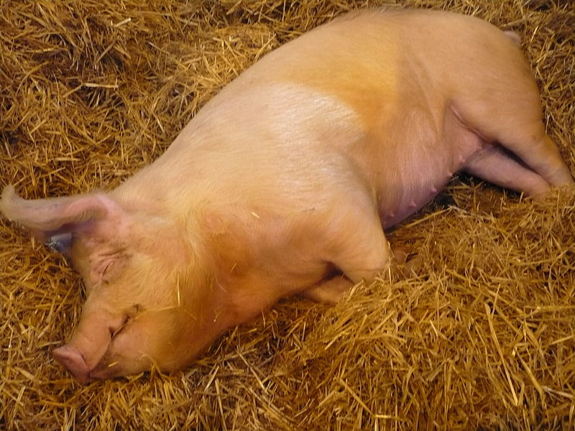
Pig!
Source: Wikipedia (Pig)

Slide 12
Pig: Example
Task: Find the top 10 most visited pages in each category
Visits
URL Info
User | Url | Time
Amy | cnn.com | 8:00
Amy | bbc.com | 10:00
Amy | flickr.com | 10:05
Fred | cnn.com | 12:00
Url | Category | PageRank
cnn.com | News | 0.9
bbc.com | News | 0.8
flickr.com | Photos | 0.7
espn.com | Sports | 0.9
Pig Slides adapted from Olston et al. (SIGMOD 2008)

Slide 13
Pig: Example Script
visits = load ‘/data/visits’ as (user, url, time);
gVisits = group visits by url;
visitCounts = foreach gVisits generate url, count(visits);
urlInfo = load ‘/data/urlInfo’ as (url, category, pRank);
visitCounts = join visitCounts by url, urlInfo by url;
gCategories = group visitCounts by category;
topUrls = foreach gCategories generate top(visitCounts,10);
store topUrls into ‘/data/topUrls’;
Pig Slides adapted from Olston et al. (SIGMOD 2008)

Slide 14
Pig Query Plan
load visits
group by url
foreach url
generate count
load urlInfo
join on url
group by category
foreach category
generate top(urls, 10)
Pig Slides adapted from Olston et al. (SIGMOD 2008)

Slide 15
Pig: MapReduce Execution
load visits
Map₁
group by url
Reduce₁
Map₂
foreach url
generate count
load urlInfo
join on url
Reduce₂
group by category
Map₃
Reduce₃
foreach category
generate top(urls, 10)
Pig Slides adapted from Olston et al. (SIGMOD 2008)

Slide 16
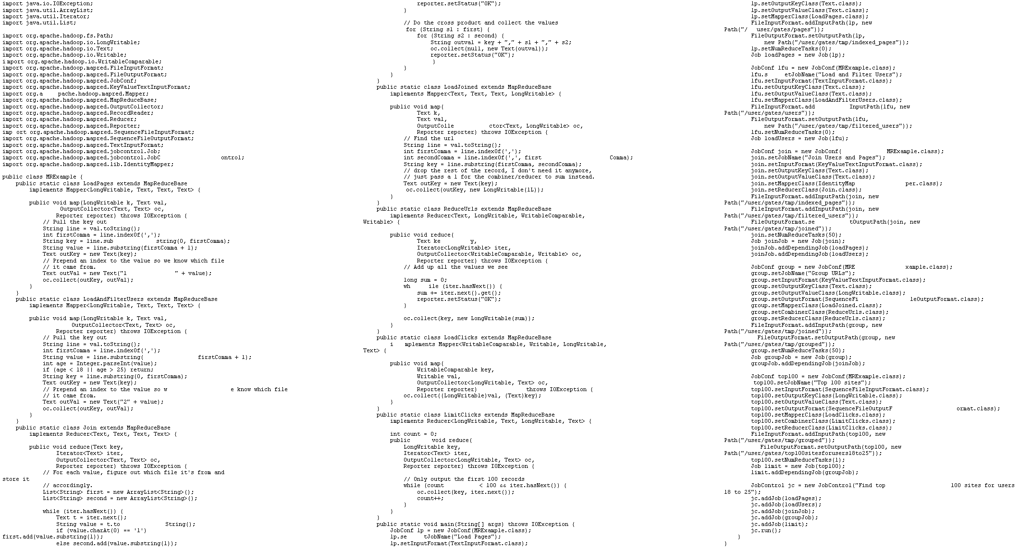
visits = load ‘/data/visits’ as (user, url, time);
gVisits = group visits by url;
visitCounts = foreach gVisits generate url, count(visits);
urlInfo = load ‘/data/urlInfo’ as (url, category, pRank);
visitCounts = join visitCounts by url, urlInfo by url;
gCategories = group visitCounts by category;
topUrls = foreach gCategories generate top(visitCounts,10);
store topUrls into ‘/data/topUrls’;
This?
Or this?

Slide 17
But isn’t Pig slower?
Sure, but c can be slower than assembly too…

Slide 18
Pig: Basics
Sequence of statements manipulating relations (aliases)
Data model
atoms
tuples
bags
maps
json

Slide 19
Pig: Common Operations
LOAD: load data (from HDFS)
FOREACH … GENERATE: per tuple processing
“map”
FILTER: discard unwanted tuples
GROUP/COGROUP: group tuples
“reduce”
JOIN: relational join
STORE: store data (to HDFS)

Slide 20
Pig: GROUPing
A = LOAD 'myfile.txt’ AS (f1: int, f2: int, f3: int);
(1, 2, 3)
(4, 2, 1)
(8, 3, 4)
(4, 3, 3)
(7, 2, 5)
(8, 4, 3)
X = GROUP A BY f1;
(1, {(1, 2, 3)})
(4, {(4, 2, 1), (4, 3, 3)})
(7, {(7, 2, 5)})
(8, {(8, 3, 4), (8, 4, 3)})

Slide 21
Pig: COGROUPing
A:
(1, 2, 3)
(4, 2, 1)
(8, 3, 4)
(4, 3, 3)
(7, 2, 5)
(8, 4, 3)
B:
(2, 4)
(8, 9)
(1, 3)
(2, 7)
(2, 9)
(4, 6)
(4, 9)
X = COGROUP A BY $0, B BY $0;
(1, {(1, 2, 3)}, {(1, 3)})
(2, {}, {(2, 4), (2, 7), (2, 9)})
(4, {(4, 2, 1), (4, 3, 3)}, {(4, 6),(4, 9)})
(7, {(7, 2, 5)}, {})
(8, {(8, 3, 4), (8, 4, 3)}, {(8, 9)})

Slide 22
Pig: JOINing
A:
(1, 2, 3)
(4, 2, 1)
(8, 3, 4)
(4, 3, 3)
(7, 2, 5)
(8, 4, 3)
B:
(2, 4)
(8, 9)
(1, 3)
(2, 7)
(2, 9)
(4, 6)
(4, 9)
X = JOIN A BY $0, B BY $0;
(1,2,3,1,3)
(4,2,1,4,6)
(4,3,3,4,6)
(4,2,1,4,9)
(4,3,3,4,9)
(8,3,4,8,9)
(8,4,3,8,9)

Slide 23
Pig UDFs
User-defined functions:
Java
Python
JavaScript
Ruby
…
UDFs make Pig arbitrarily extensible
Express “core” computations in UDFs
Take advantage of Pig as glue code for scale-out plumbing

Slide 24
The datacenter is the computer!
What’s the instruction set?
Okay, let’s fix this!
Source: Google

Slide 25
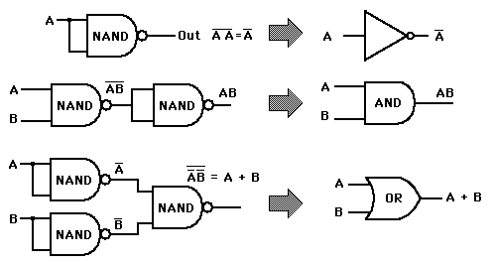
Analogy: NAND Gates are universal

Slide 26
Let’s design a data processing language “from scratch”!
(Why is MapReduce the way it is?)

Slide 27
Data-Parallel Dataflow Languages
We have a collection of records,
want to apply a bunch of operations to compute some result
Assumptions: static collection, records
(what’s the limitation here?)

Slide 28
We need per-record processing
r₁
r₂
r₃
r₄
…
r_{n-1}
r_{n}
map
map
map
…
r’₁
r'₂
r’₃
r’₄
…
r'_{n-1}
r_{n}
Remarks: Easy to parallelize maps, record to “mapper” assignment is an implementation detail

Slide 29
Map alone isn’t enough
(If we want more than embarrassingly parallel processing)
Where do intermediate results go?
We need an addressing mechanism!
What’s the semantics of the group by?
Once we resolve the addressing, apply another computation
That’s what we call reduce!
(What’s with the sorting then?)

Slide 30
MapReduce
r₁
r₂
r₃
r₄
…
r_{n-1}
r_{n}
map
map
map
…
reduce
reduce
…
reduce
r’₁
r'₂
r’₃
r’₄
…
r'_{n-1}
r_{n}
MapReduce is the minimally “interesting” dataflow!

Slide 31
MapReduce
List[(K1,V1)]
map f: (K1, V1) ⇒ List[(K2, V2)]
reduce g: (K2, Iterable[V2]) ⇒ List[(K3, V3)]
List[K2,V2])
(note we’re abstracting the “data-parallel” part)

Slide 32
MapReduce Workflows
HDFS
map
map
map
map
reduce
reduce
reduce
reduce
HDFS
HDFS
HDFS
HDFS
What’s wrong?

Slide 33
Want MM?
HDFS
HDFS
map
map
map
map
HDFS
HDFS
HDFS
✔
✗

Slide 34
Want MRR?
HDFS
HDFS
map
map
map
reduce
reduce
reduce
reduce
HDFS
HDFS
HDFS
✔
✗

Slide 35
The datacenter is the computer!
Let’s enrich the instruction set!
Source: Google

Slide 36
Dryad: Graph Operators
Source: Isard et al. (2007) Dryad: Distributed Data-Parallel Programs from Sequential Building Blocks. EuroSys.

Slide 37
Dryad: Architecture
The Dryad system organization. The job manager (JM) consults the name server (NS) to discover the list of available computers. It maintains the job graph and schedules running vertices (V) as computers become available using the daemon (D) as a proxy. Vertices exchange data through files, TCP pipes, or shared-memory channels. The shaded bar indicates the vertices in the job that are currently running.
Source: Isard et al. (2007) Dryad: Distributed Data-Parallel Programs from Sequential Building Blocks. EuroSys.

Slide 38
Dryad: Cool Tricks
Channel: abstraction for vertex-to-vertex communication
File
TCP pipe
Shared memory
Runtime graph refinement
Size of input is not known until runtime
Automatically rewrite graph based on invariant properties
Source: Isard et al. (2007) Dryad: Distributed Data-Parallel Programs from Sequential Building Blocks. EuroSys.

Slide 39
Dryad: Sample Program
Source: Isard et al. (2007) Dryad: Distributed Data-Parallel Programs from Sequential Building Blocks. EuroSys.

Slide 40
DryadLINQ
LINQ = Language INtegrated Query
.NET constructs for combining imperative and declarative programming
Developers write in DryadLINQ
Program compiled into computations that run on Dryad
Sound familiar?
Source: Yu et al. (2008) DryadLINQ: A System for General-Purpose Distributed Data-Parallel Computing Using a High-Level Language. OSDI.

Slide 41
DryadLINQ: Word Count
PartitionedTable<LineRecord> inputTable =
PartitionedTable.Get<LineRecord>(uri);
IQueryable<string> words = inputTable.SelectMany(x => x.line.Split(' '));
IQueryable<IGrouping<string, string>> groups = words.GroupBy(x => x);
IQueryable<Pair> counts = groups.Select(x => new Pair(x.Key, x.Count()));
IQueryable<Pair> ordered = counts.OrderByDescending(x => x.Count);
IQueryable<Pair> top = ordered.Take(k);
Compare:
a = load ’file.txt' as (text: chararray);
b = foreach a generate flatten(TOKENIZE(text)) as term;
c = group b by term;
d = foreach c generate group as term, COUNT(b) as count;
store d into 'cnt';
Compare and contrast…

Slide 42
What happened to Dryad?
The Dryad system organization. The job manager (JM) consults the name server (NS) to discover the list of available computers. It maintains the job graph and schedules running vertices (V) as computers become available using the daemon (D) as a proxy. Vertices exchange data through files, TCP pipes, or shared-memory channels. The shaded bar indicates the vertices in the job that are currently running.
Source: Isard et al. (2007) Dryad: Distributed Data-Parallel Programs from Sequential Building Blocks. EuroSys.

Slide 43
Data-Parallel Dataflow Languages
We have a collection of records,
want to apply a bunch of operations to compute some result
What are the dataflow operators?

Slide 44
Spark
Answer to “What’s beyond MapReduce?”
Brief history:
Developed at UC Berkeley AMPLab in 2009
Open-sourced in 2010
Became top-level Apache project in February 2014
Commercial support provided by DataBricks

Slide 45
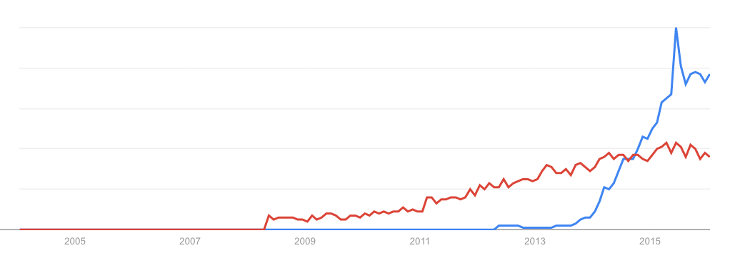
Spark vs. Hadoop
November 2014
Google Trends
Source: Datanami (2014): http://www.datanami.com/2014/11/21/spark-just-passed-hadoop-popularity-web-heres/

Slide 46
What’s an RDD?
Resilient Distributed Dataset (RDD)
Much more next session…

Slide 47
MapReduce
List[(K1,V1)]
map f: (K1, V1) ⇒ List[(K2, V2)]
reduce g: (K2, Iterable[V2]) ⇒ List[(K3, V3)]
List[K2,V2])

Slide 48
Map-like Operations
RDD[T]
RDD[T]
RDD[T]
RDD[T]
map f: (T) ⇒ U
filter f: (T) ⇒ Boolean
flatMap f: (T) ⇒ TraversableOnce[U]
mapPartitions f: (Iterator[T]) ⇒ Iterator[U]
RDD[U]
RDD[T]
RDD[U]
RDD[U]
(Not meant to be exhaustive)

Slide 49
Reduce-like Operations
RDD[(K, V)]
RDD[(K, V)]
RDD[(K, V)]
groupByKey
reduceByKey
f: (V, V) ⇒ V
aggregateByKey
seqOp: (U, V) ⇒ U, combOp: (U, U) ⇒ U
RDD[(K, Iterable[V])]
RDD[(K, V)]
RDD[(K, U)]
(Not meant to be exhaustive)

Slide 50
Sort Operations
RDD[(K, V)]
RDD[(K, V)]
sort
repartitionAnd SortWithinPartitions
RDD[(K, V)]
RDD[(K, V)]
(Not meant to be exhaustive)

Slide 51
Join-like Operations
RDD[(K, V)]
RDD[(K, W)]
RDD[(K, V)]
RDD[(K, W)]
join
cogroup
RDD[(K, (V, W))]
RDD[(K, (Iterable[V], Iterable[W]))]
(Not meant to be exhaustive)

Slide 52
Join-like Operations
RDD[(K, V)]
RDD[(K, W)]
RDD[(K, V)]
RDD[(K, W)]
leftOuterJoin
fullOuterJoin
RDD[(K, (V, Option[W]))]
RDD[(K, (Option[V], Option[W]))]
(Not meant to be exhaustive)

Slide 53
Set-ish Operations
RDD[T]
RDD[T]
RDD[T]
RDD[T]
union
intersection
RDD[T]
RDD[T]
(Not meant to be exhaustive)

Slide 54
Set-ish Operations
RDD[T]
RDD[T]
RDD[U]
distinct
cartesian
RDD[T]
RDD[(T, U)]
(Not meant to be exhaustive)

Slide 55
MapReduce in Spark?
RDD[T]
RDD[T]
map f: (T) ⇒ (K,V)
flatMap f: (T) ⇒ TO[(K,V)]
reduceByKey
f: (V, V) ⇒ V
reduceByKey
f: (V, V) ⇒ V
RDD[(K, V)]
RDD[(K, V)]
Not quite…

Slide 56
MapReduce in Spark?
RDD[T]
RDD[T]
flatMap f: (T) ⇒ TO[(K,V)]
mapPartitions f: (Iter[T]) ⇒ Iter[(K,V)]
groupByKey
groupByKey
map f: ((K, Iter[V])) ⇒ (R,S)
map f: ((K, Iter[V])) ⇒ (R,S)
Nope, this isn’t “odd”
RDD[(R, S)]
RDD[(R, S)]
Still not quite…

Slide 57
Spark Word Count
val textFile = sc.textFile(args.input())
textFile
.flatMap(line => tokenize(line))
.map(word => (word, 1))
.reduceByKey(_ + _)
.saveAsTextFile(args.output())
(x, y) => x + y
Aside: Scala tuple access notation, e.g.,
a._1

Slide 58
Don’t focus on Java verbosity!
val textFile = sc.textFile(args.input())
textFile
.map(object mapper {
def map(key: Long, value: Text) =
tokenize(value).foreach(word => write(word, 1))
})
.reduce(object reducer {
def reduce(key: Text, values: Iterable[Int]) = {
var sum = 0
for (value <- values) sum += value
write(key, sum)
})
.saveAsTextFile(args.output())

Slide 59
Next Time…
What’s an RDD?
How does Spark actually work?
Algorithm design: redux

Slide 60

Questions?
Source: Wikipedia (Japanese rock garden)

